Slide 2
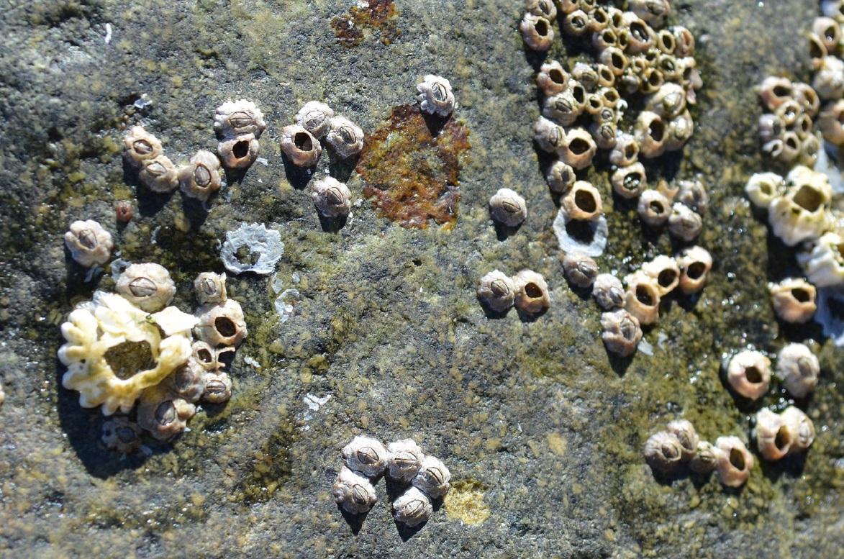
barnacles
Photo courtesy of mag3737 (@flickr.com) - granted under creative commons licence – attribution

Slide 3
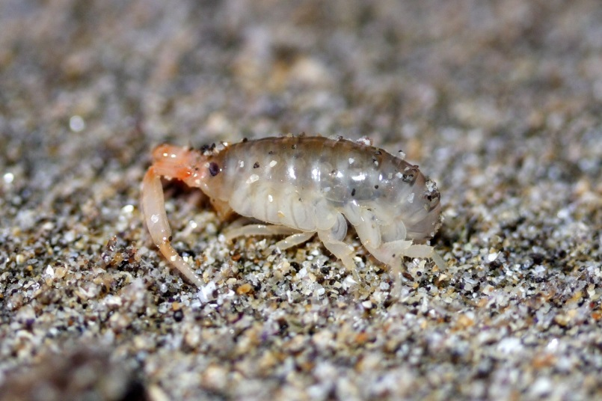
beach hopper
Photo courtesy of Ken-ichi (@flickr.com) - granted under creative commons licence – attribution

Slide 4
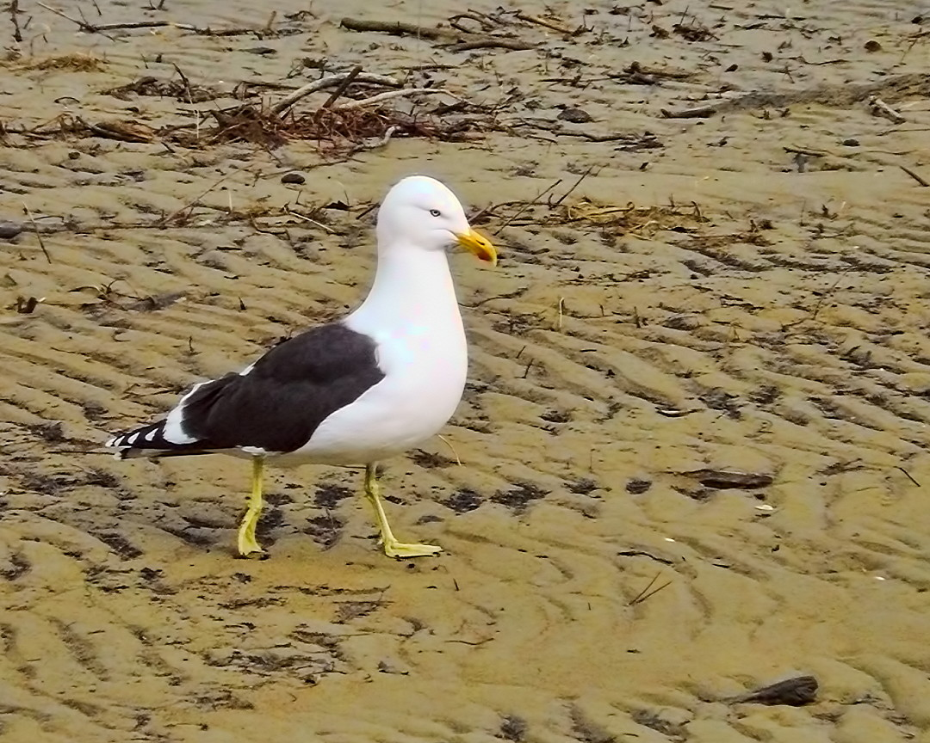
black-backed seagull
Photo courtesy of SidPix (@flickr.com) - granted under creative commons licence – attribution

Slide 5
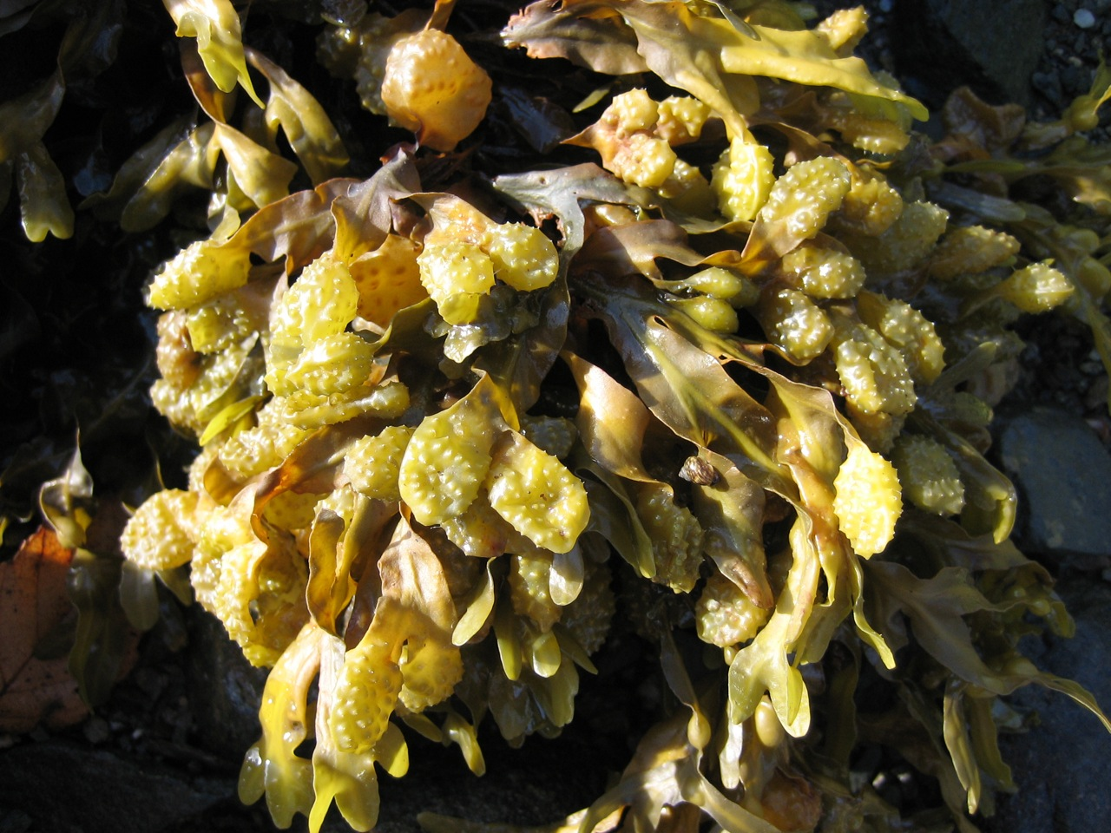
bladder wrack seaweed
Photo courtesy of cmurtaugh (@flickr.com) - granted under creative commons licence – attribution

Slide 6
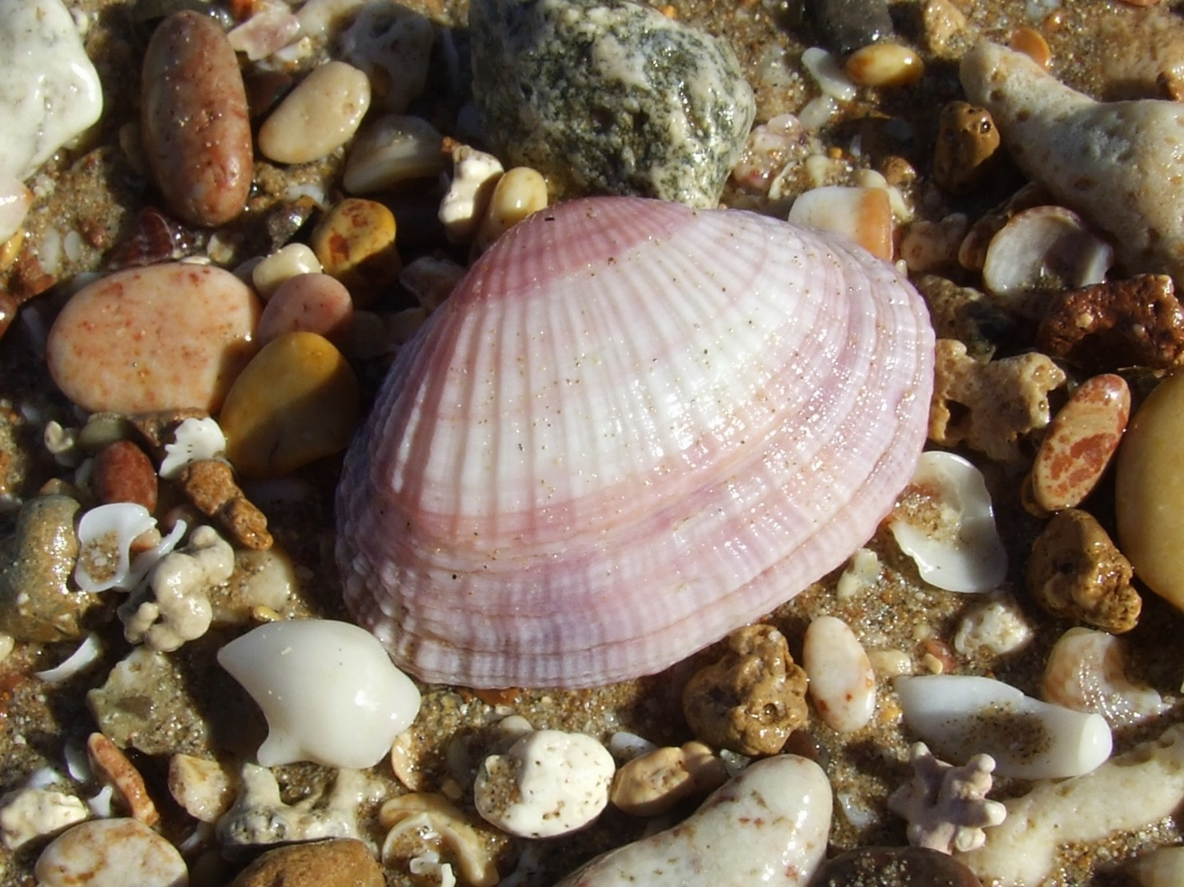
cockle
Photo courtesy of Bill & Mark Bell (@flickr.com) - granted under creative commons licence – attribution

Slide 7
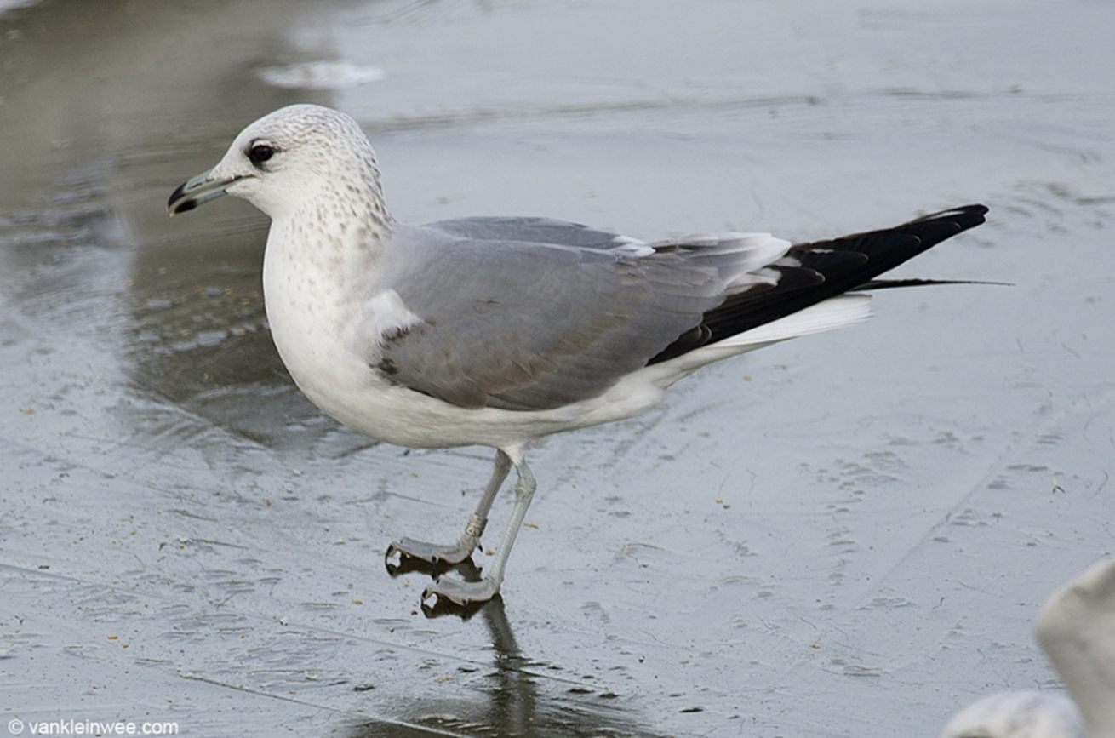
common gull
Photo courtesy of little-W | Studying gulls (@flickr.com) - granted under creative commons licence – attribution

Slide 8
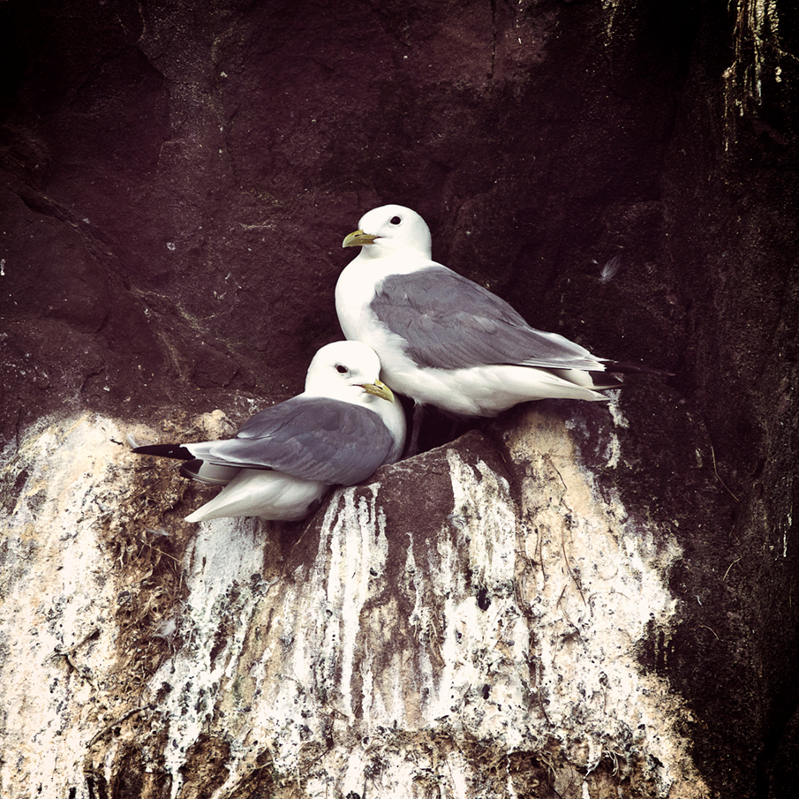
kittiwakes
Photo courtesy of SIDwilliams (@flickr.com) - granted under creative commons licence – attribution

Slide 9
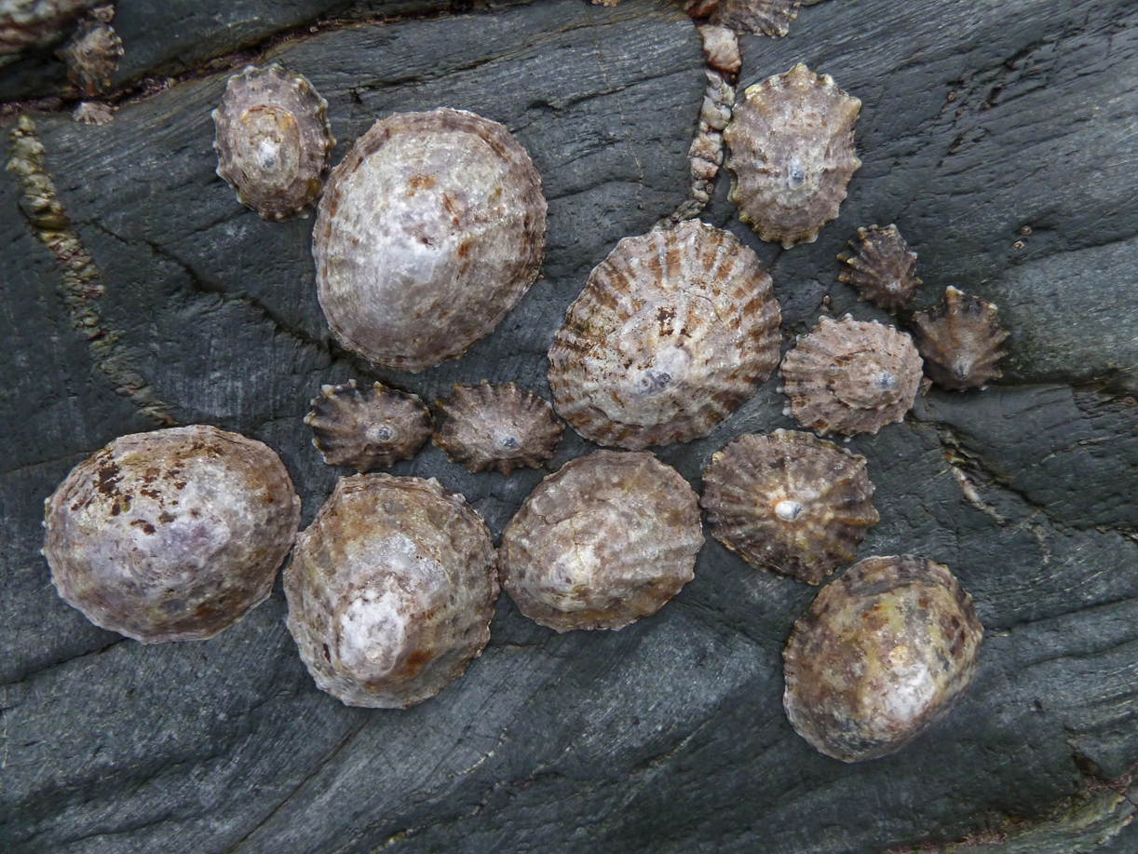
limpets
Photo courtesy of Tim Green aka atoach (@flickr.com) - granted under creative commons licence – attribution

Slide 10
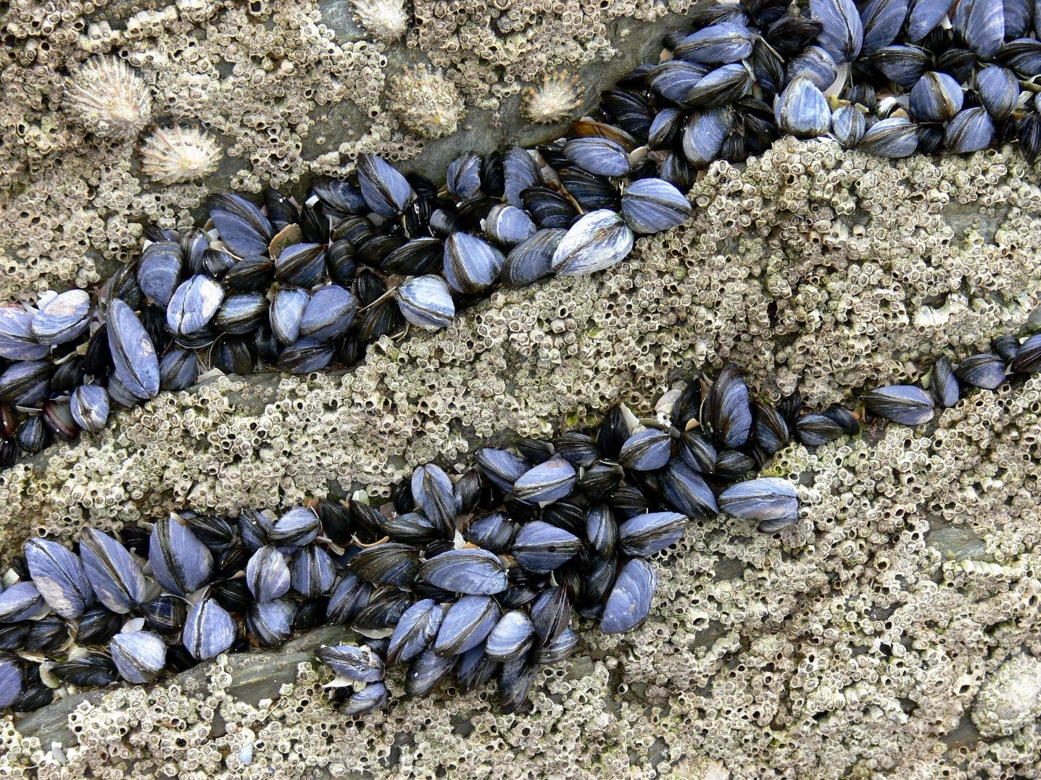
mussels
Photo courtesy of S John Davey (@flickr.com) - granted under creative commons licence – attribution

Slide 11
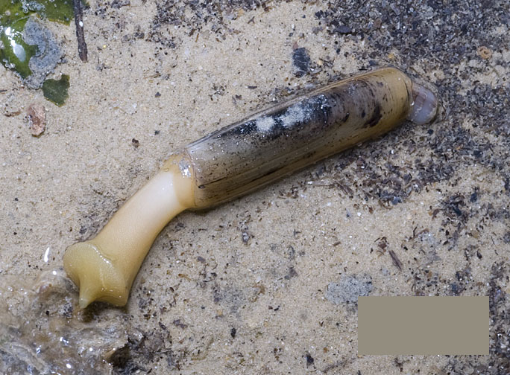
razor clam
Photo courtesy of wildsingapore (@flickr.com) - granted under creative commons licence – attribution

Slide 12
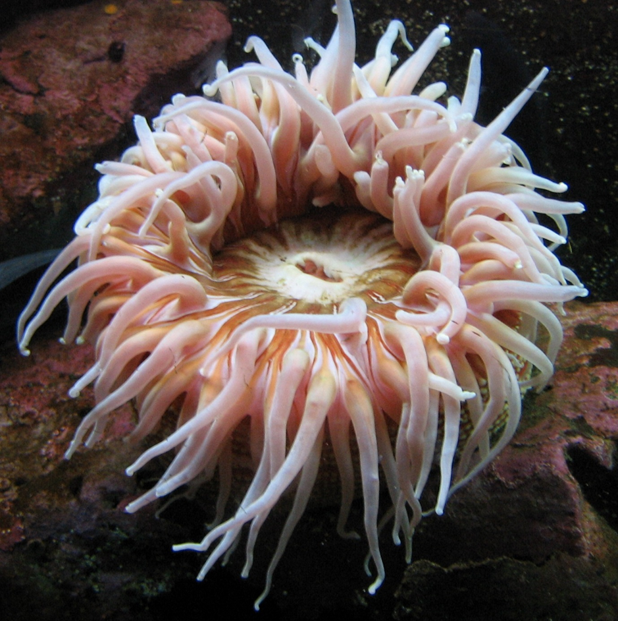
sea anemone
Photo courtesy of wildsingapore (@flickr.com) - granted under creative commons licence – attribution

Slide 13
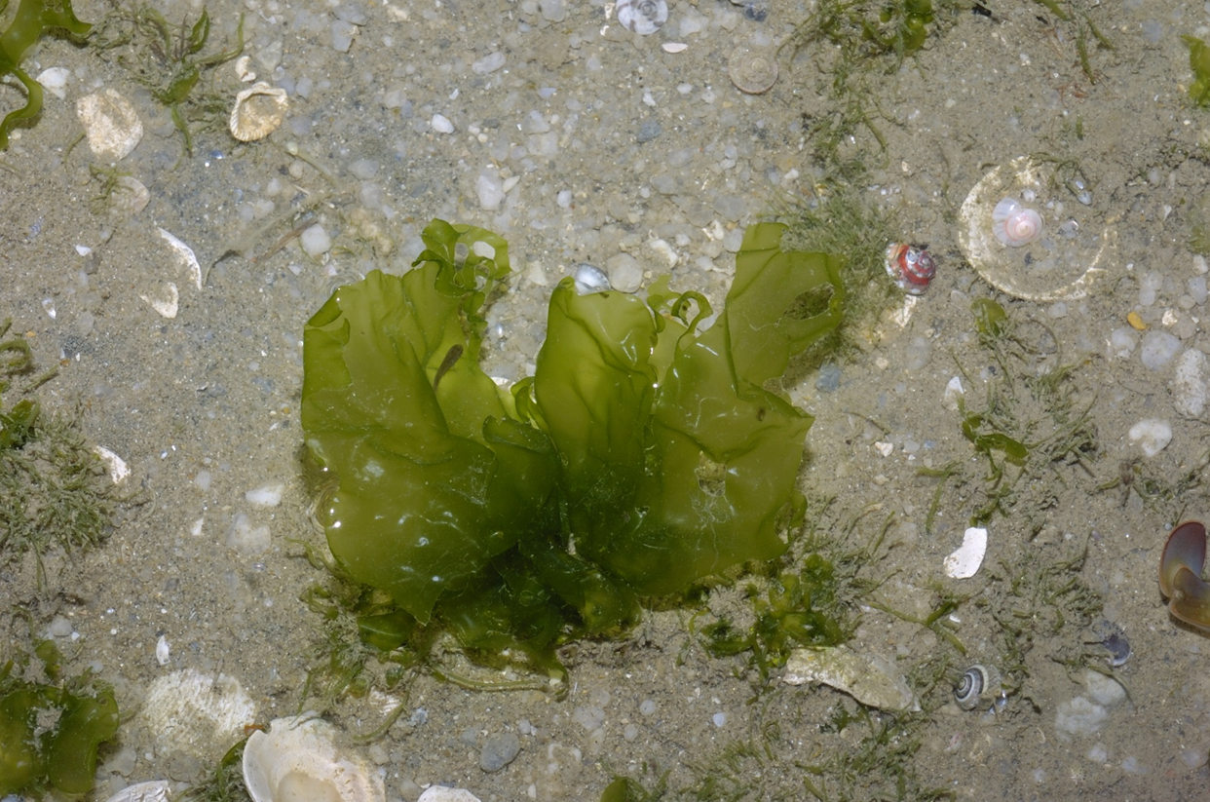
sea lettuce
Photo courtesy of wildsingapore (@flickr.com) - granted under creative commons licence – attribution

Slide 14
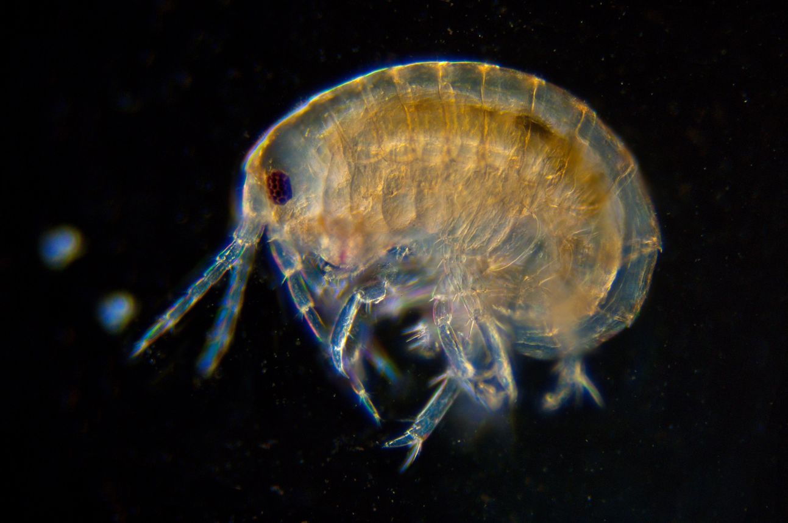
shrimp
Photo courtesy of nebarnix (@flickr.com) - granted under creative commons licence – attribution

